Slide 1

2025 ETH Quantum Hackaton ZuriQ challenge
The “One Penny Guys and Girl” Team

Slide 2
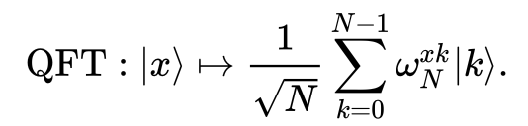
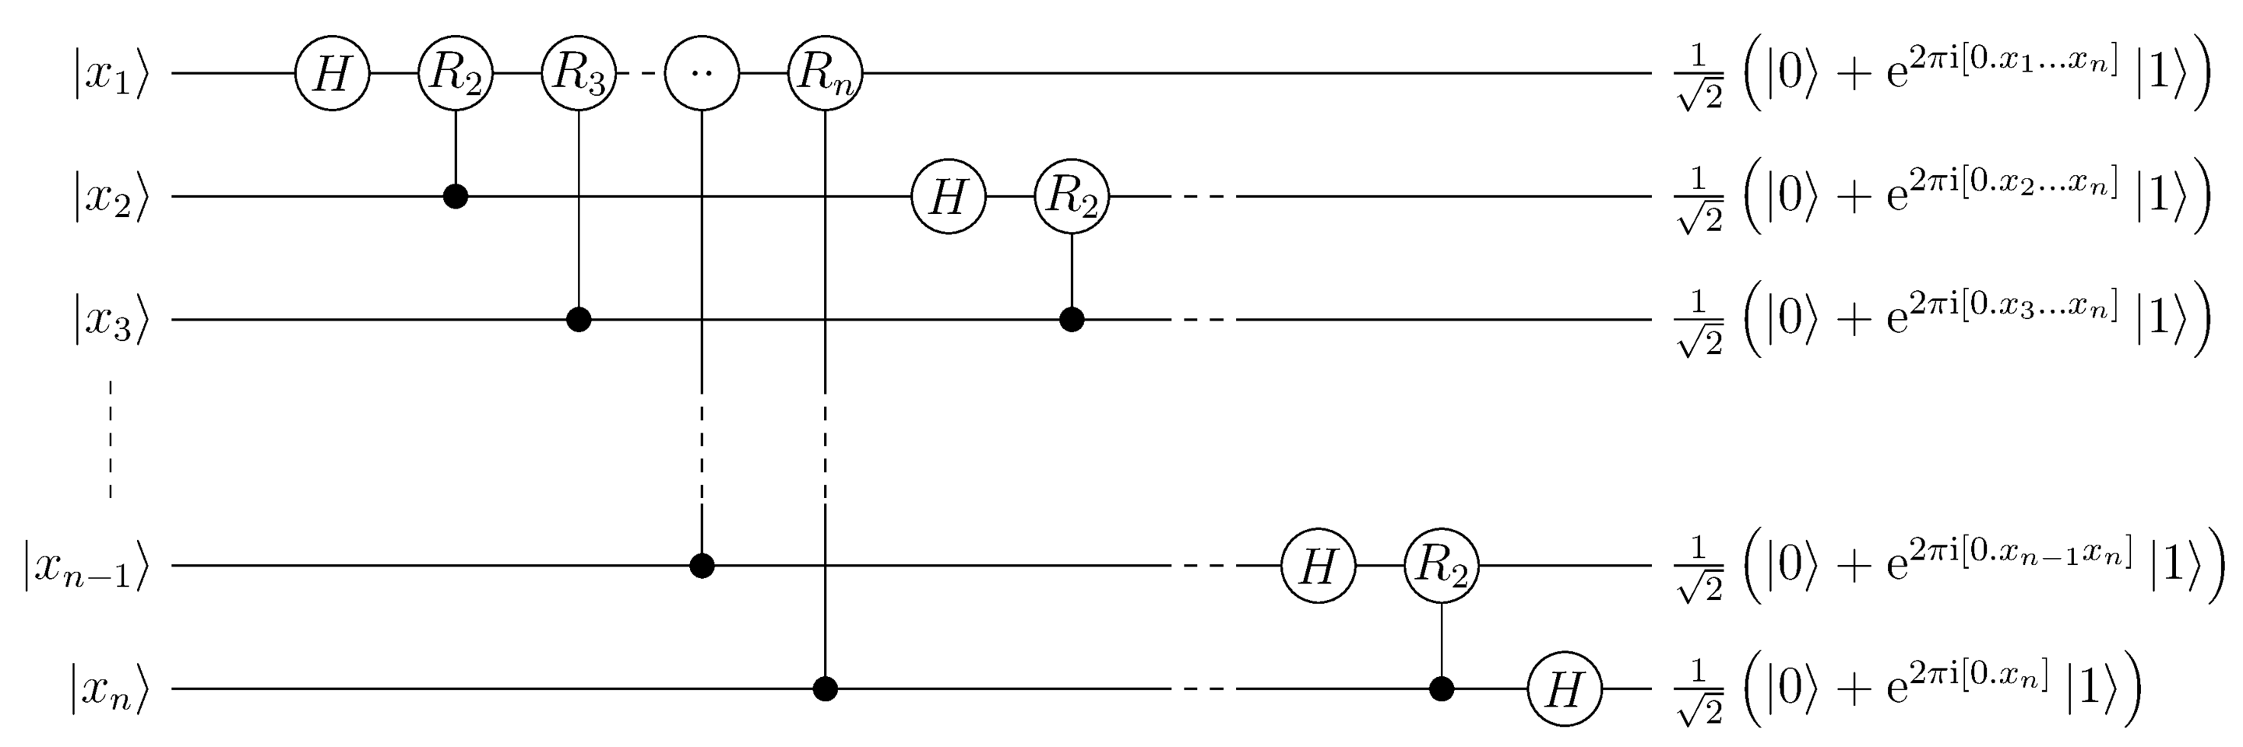
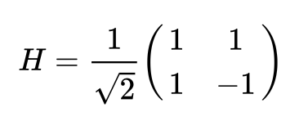
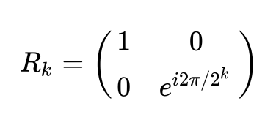
The standard qft8 circuit:
We want to do the same, but for 8 “shuttleable” ions on a 5x7grid, and using {RX, RY, MS} as universal gate set

Slide 3
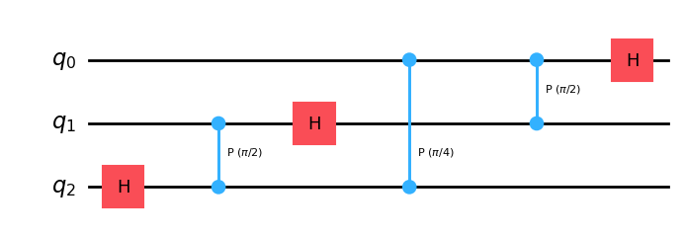
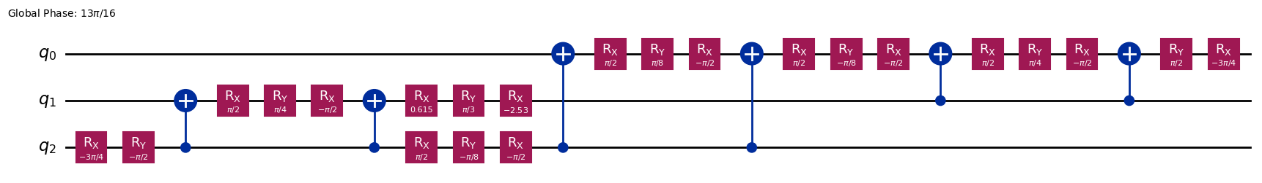
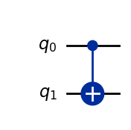
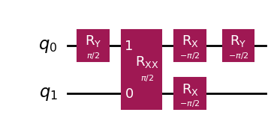
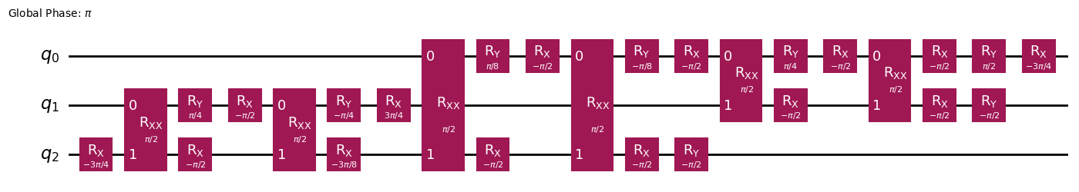
Circuit compilation pipeline:
qiskit transpiler
Use:
=
And more qiskit magic

Slide 4
Okay this looks pretty decent but how do we translate it into moving ions in Penning traps and lasers?
The routing + scheduling problem:

Slide 5
The routing + scheduling problem:
We decided to tackle the problem in two complementary ways
One 2-qubit gate at a time in a manually optimized scheme
Using multi-agent path finding algorithms for parallelism

Slide 6
Using a simpler grid

Slide 7
Using a simpler grid

Slide 8
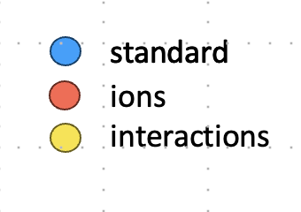
Defining starting positions
Simpler grid is enough with this “one interaction at a time” approach
Define convenient starting points
Ions move back to their starting position

Slide 9


Perform an interaction
Simpler grid is enough with this “one interaction at a time” approach
Define convenient starting points
Ions move back to their starting position

Slide 10
Compiler versions through the night
One movement at a time
Qubits move in pairs
# of steps | 611
F(noisy) | 92.2%
# of steps | 539
F(noisy) | 93.9%
Better single qubit
gate timing
Introduce idling
# of steps | 448
F(noisy) | 96.7%
# of steps | 437
F(noisy) | 95.8%

Slide 11
The movie

Slide 12
With arbitrary MS angles
One movement at a time
# of steps | Fidelity with noise
611 | 92.2%
Qubits move in pairs
# of steps | Fidelity with noise
539 | 93.9%
Using MS with custom angles
# of steps | Fidelity with noise
230 | 99.5%
Better single qubit gate timing
# of steps | Fidelity with noise
437 | 95.8%
Introduce idling
# of steps | Fidelity with noise
448 | 96.7%

Slide 13
Scaling
Storage nodes
Transition
Interaction

Slide 14
Using multi-agent pathfinding:
Start from list of instrucitons
Assign the destintions as the most convenient interaction node
Let a multi-agent path finding algorithm work
Use idle time to perform single qubit rotations
=> Use parallelism!

Slide 15
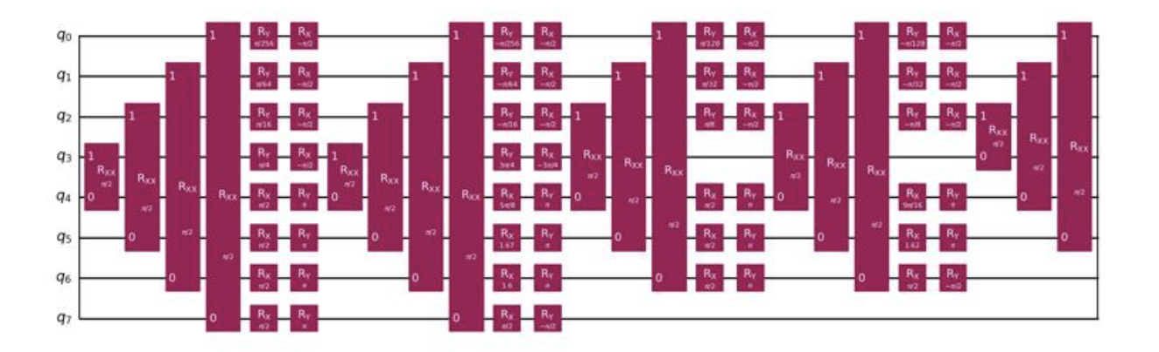
Using multi-agent pathfinding:
But our decomposition doesn’t allow for many simulataneous entangling gates
Ideally can be parallelized

Slide 16
Main strategies
Initial positions at the perimeter of 5x5 sub-grid → shortest distance + avoid being an obstacle
Ions for 2 qubit gates are performed at the closest interaction node
Use path finding to reach interaction node
High weights on edges that lead to occupied node
To avoid collisions: project paths and if needed delay 1 time step
No SWAPs allowed
Once interaction is finished, ions go to their initial positions
Single qubit gates are squeezed in between 2 qubit gates
NOTE: not specific to QFT but generalizable

